Slide 1
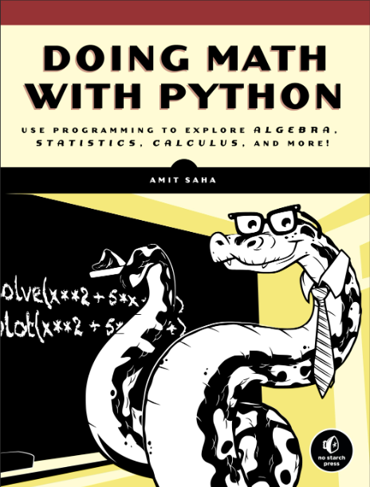


Doing Math with Python
GitHub: https://github.com/yasenstar/DoingMathWithPython
Gitee: https://gitee.com/yasenstar/DoingMathWithPython
Yasen – Enterprise Architecture
YouTube: @yasenzhao

Slide 2
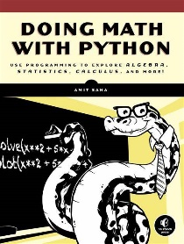
Doing Math with Python Opening and Intro
001
GitHub: https://github.com/yasenstar/DoingMathWithPython
Gitee: https://gitee.com/yasenstar/DoingMathWithPython
Yasen – Enterprise Architecture
YouTube: @yasenzhao

Slide 3
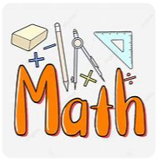
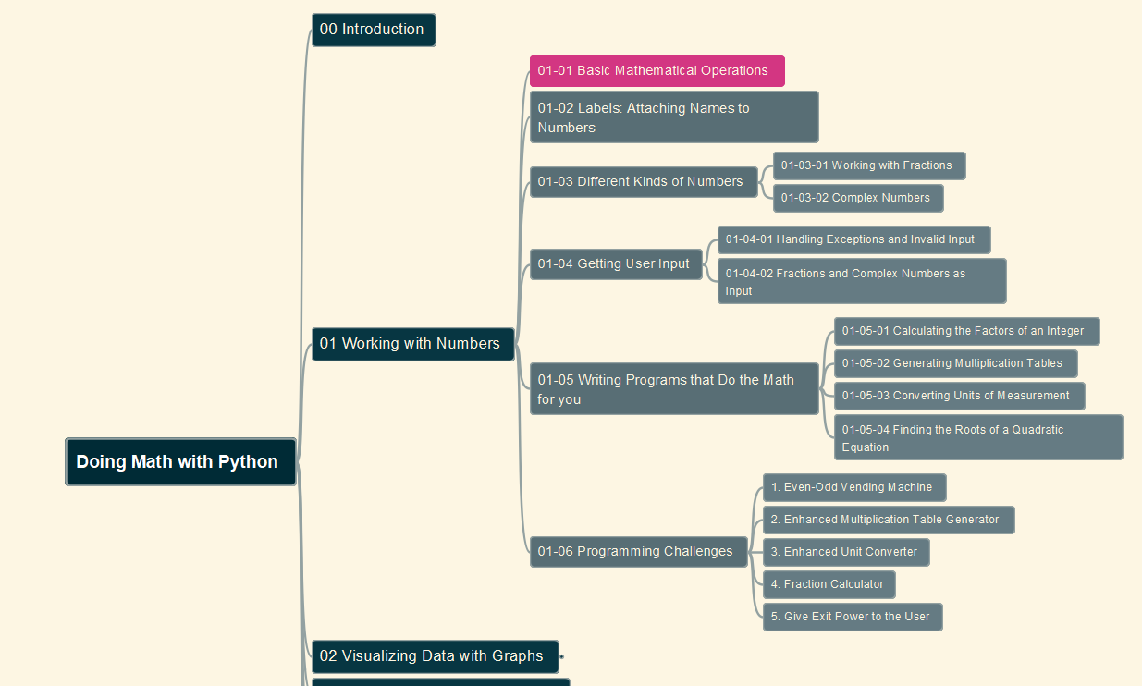
Doing Math with Python
002
Chapter 01: Working with Numbers
01-01 Basic Mathematical Operations
GitHub: https://github.com/yasenstar/DoingMathWithPython
Gitee: https://gitee.com/yasenstar/DoingMathWithPython
Yasen – Enterprise Architecture
YouTube: @yasenzhao

Slide 4
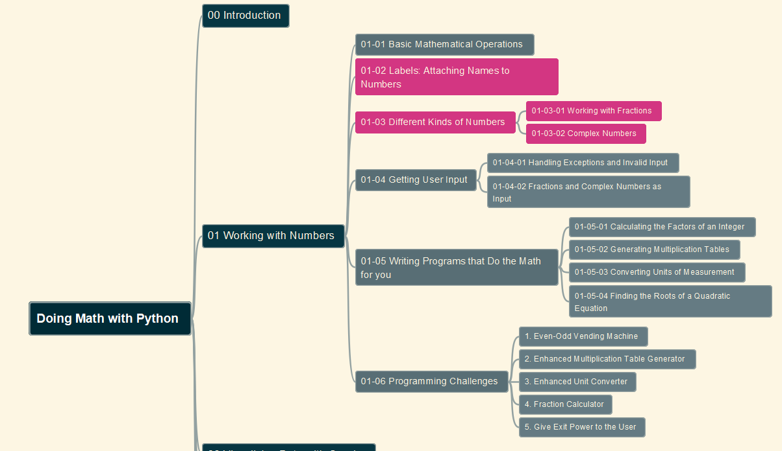
Doing Math with Python
003
Chapter 01: Working with Numbers
01-02 Labels: Attaching Names to Numbers
01-03 Different Kinds of Numbers
GitHub: https://github.com/yasenstar/DoingMathWithPython
Gitee: https://gitee.com/yasenstar/DoingMathWithPython
Yasen – Enterprise Architecture
YouTube: @yasenzhao

Slide 5
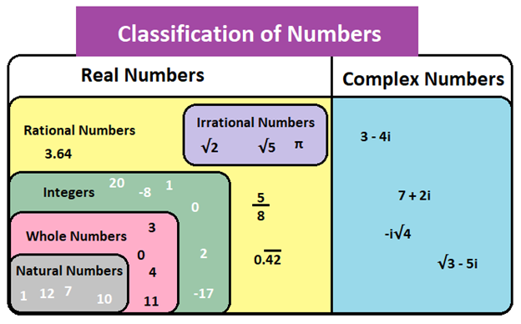
About Number’s Definition and Range

Slide 6
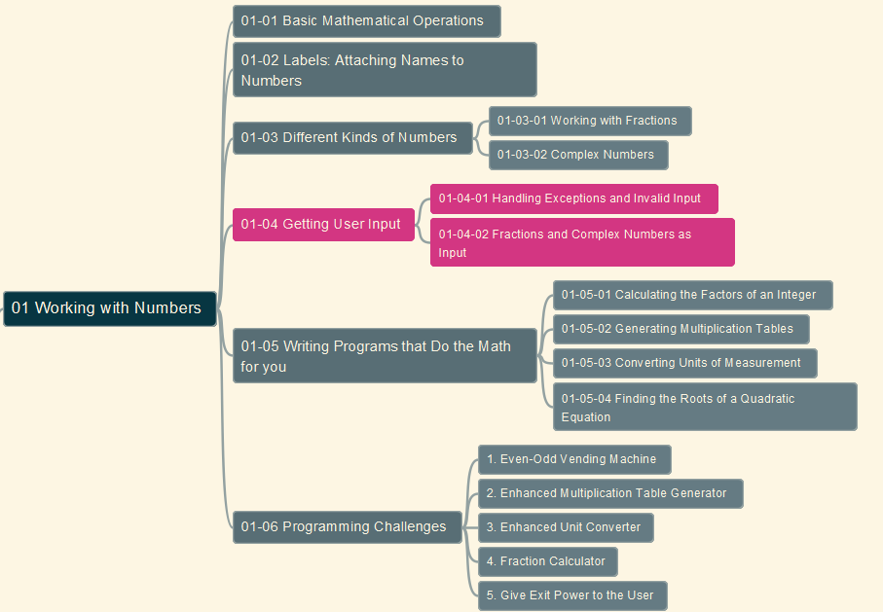
Doing Math with Python
004
Chapter 01: Working with Numbers
01-04 Getting User Input
GitHub: https://github.com/yasenstar/DoingMathWithPython
Gitee: https://gitee.com/yasenstar/DoingMathWithPython
Yasen – Enterprise Architecture
YouTube: @yasenzhao

Slide 7
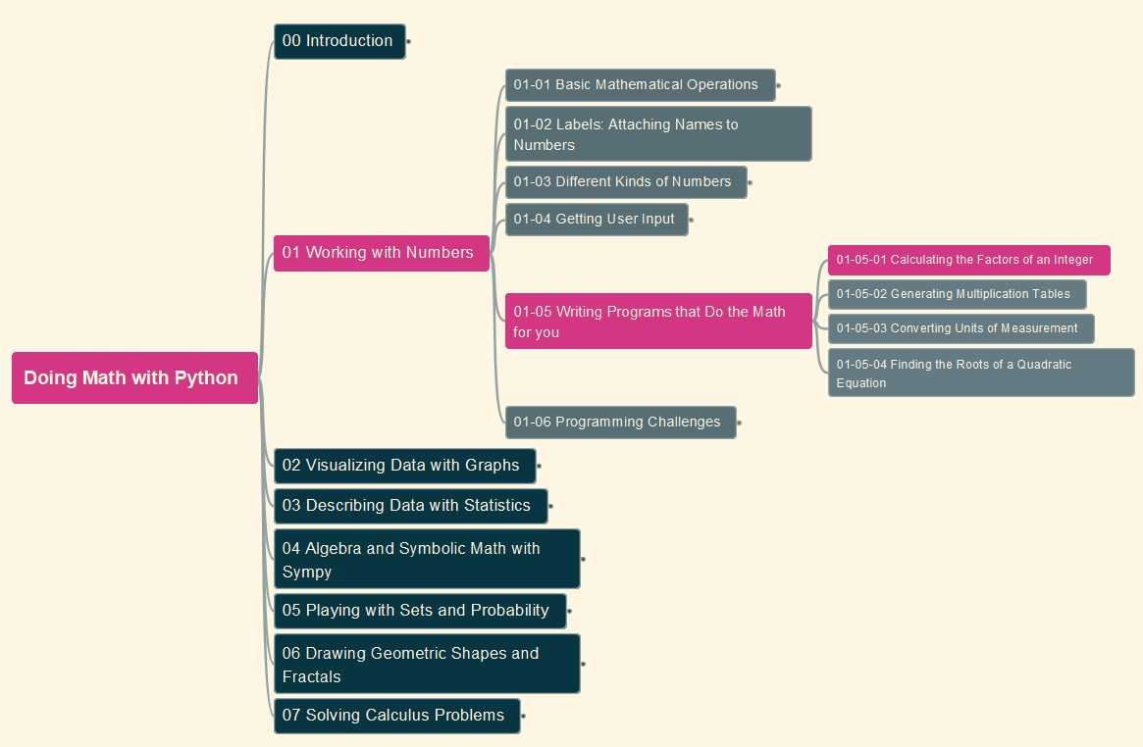
Doing Math with Python
005
Chapter 01: Working with Numbers
01-05 Writing Programs that Do the Math (1)
GitHub: https://github.com/yasenstar/DoingMathWithPython
Gitee: https://gitee.com/yasenstar/DoingMathWithPython
Yasen – Enterprise Architecture
YouTube: @yasenzhao

Slide 8

Doing Math with Python
006
Chapter 01: Working with Numbers
01-05 Writing Programs that Do the Math (2)
GitHub: https://github.com/yasenstar/DoingMathWithPython
Gitee: https://gitee.com/yasenstar/DoingMathWithPython
Yasen – Enterprise Architecture
YouTube: @yasenzhao

Slide 9
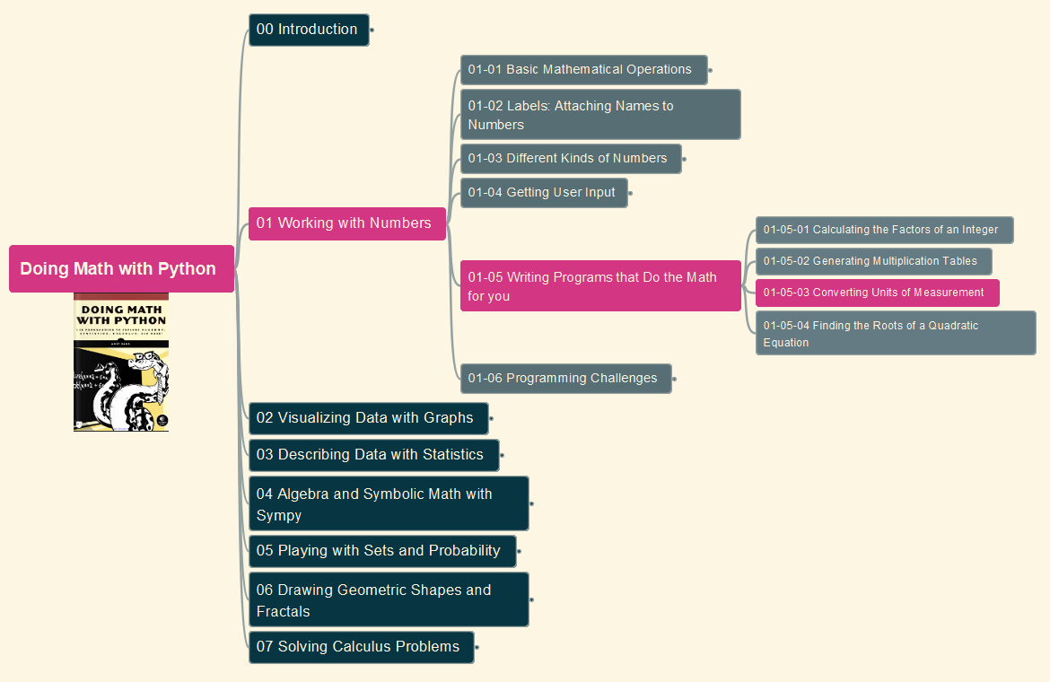
Doing Math with Python
007
Chapter 01: Working with Numbers
01-05 Writing Programs that Do the Math (3)
GitHub: https://github.com/yasenstar/DoingMathWithPython
Gitee: https://gitee.com/yasenstar/DoingMathWithPython
Yasen – Enterprise Architecture
YouTube: @yasenzhao

Slide 10
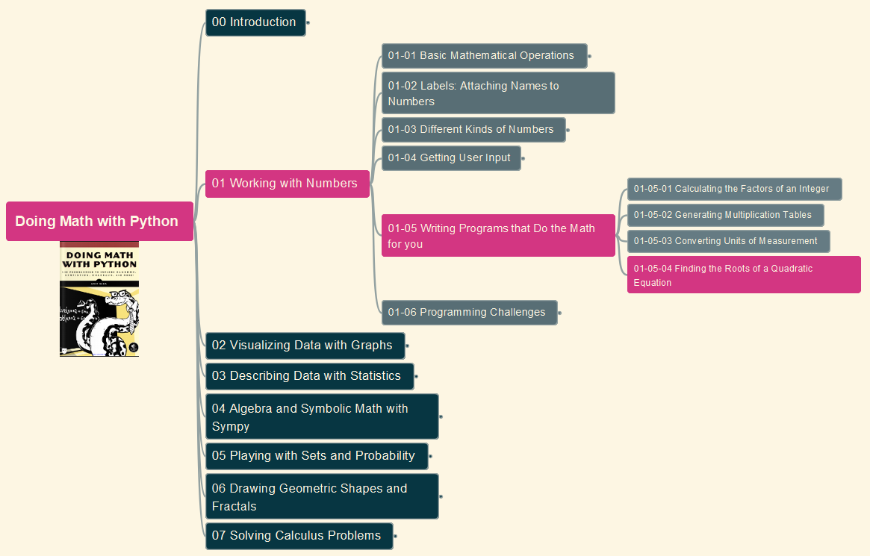
Doing Math with Python
008
Chapter 01: Working with Numbers
01-05 Writing Programs that Do the Math (4)
GitHub: https://github.com/yasenstar/DoingMathWithPython
Gitee: https://gitee.com/yasenstar/DoingMathWithPython
Yasen – Enterprise Architecture
YouTube: @yasenzhao

Slide 11
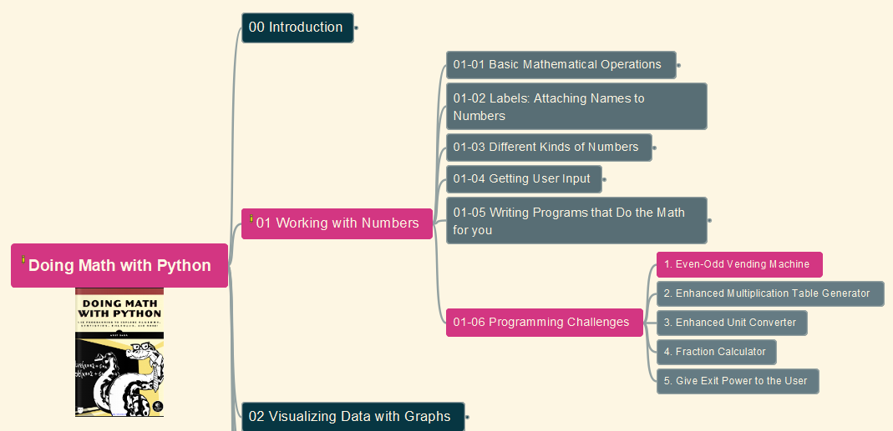

Doing Math with Python
009
Chapter 01: Working with Numbers
Challenges #1: Even-Odd Vending Machine
GitHub: https://github.com/yasenstar/DoingMathWithPython
Gitee: https://gitee.com/yasenstar/DoingMathWithPython
Yasen – Enterprise Architecture
YouTube: @yasenzhao

Slide 12
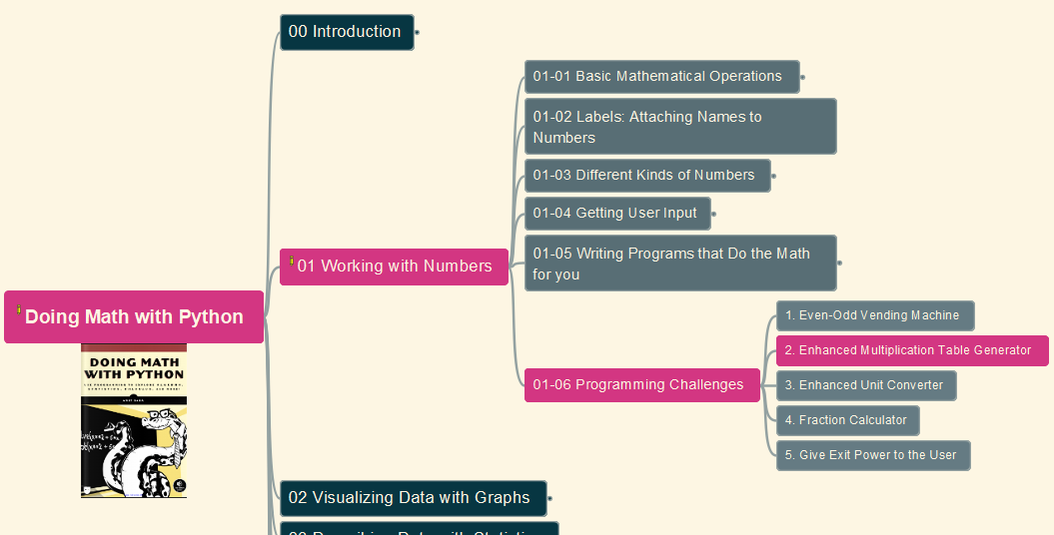

Doing Math with Python
010
Chapter 01: Working with Numbers
Challenges #2: Enhanced Multiplication Table Generator
GitHub: https://github.com/yasenstar/DoingMathWithPython
Gitee: https://gitee.com/yasenstar/DoingMathWithPython
Yasen – Enterprise Architecture
YouTube: @yasenzhao

Slide 13
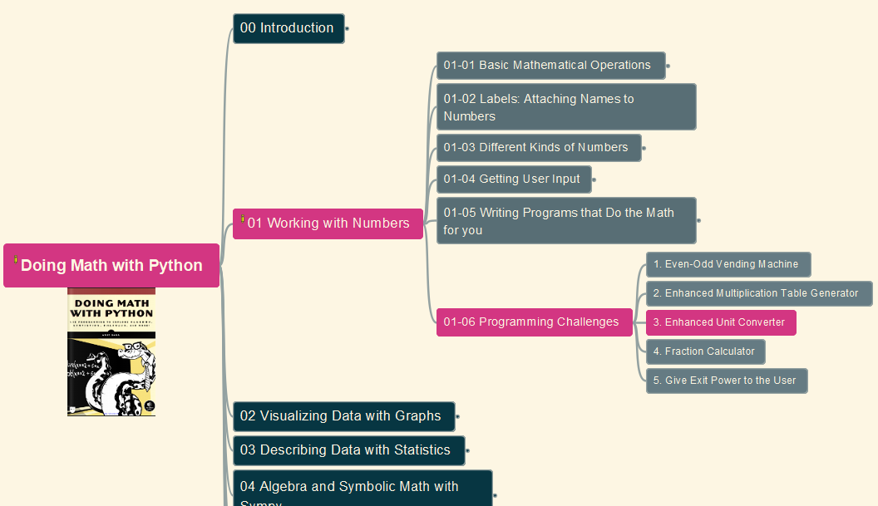

Doing Math with Python
011
Chapter 01: Working with Numbers
Challenges #3: Enhanced Unit Converter
GitHub: https://github.com/yasenstar/DoingMathWithPython
Gitee: https://gitee.com/yasenstar/DoingMathWithPython
Yasen – Enterprise Architecture
YouTube: @yasenzhao

Slide 14
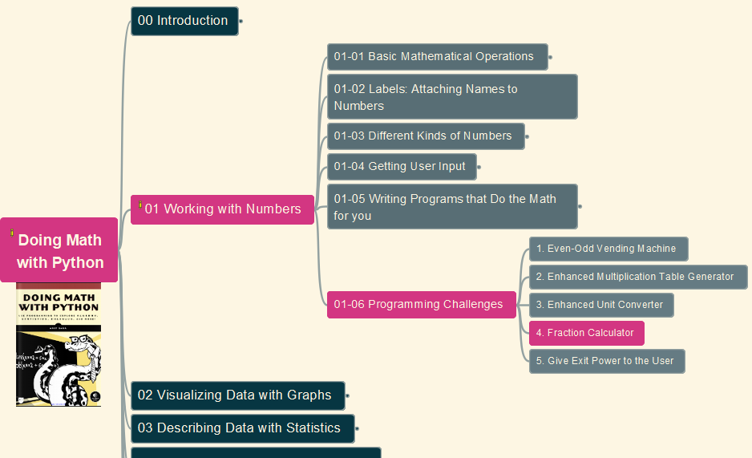
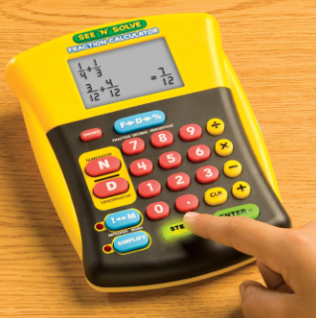
Doing Math with Python
012
Chapter 01: Working with Numbers
Challenges #4: Fraction Calculator
GitHub: https://github.com/yasenstar/DoingMathWithPython
Gitee: https://gitee.com/yasenstar/DoingMathWithPython
Yasen – Enterprise Architecture
YouTube: @yasenzhao

Slide 15
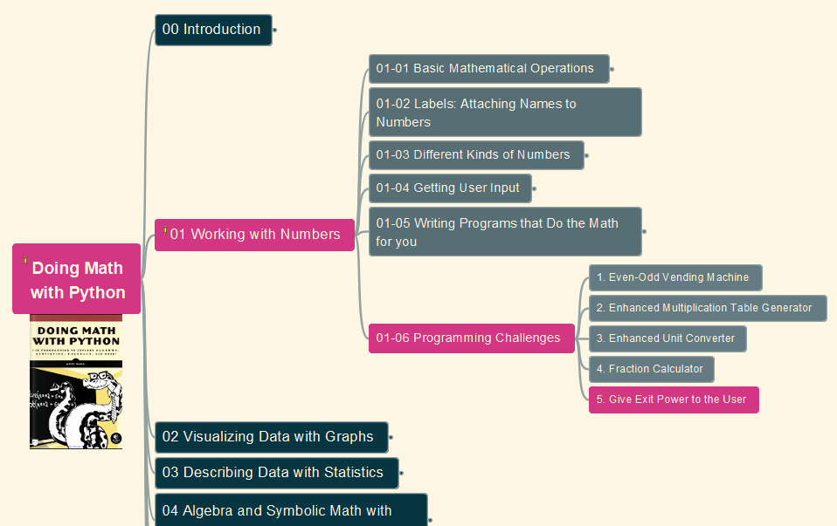

Doing Math with Python
013
Chapter 01: Working with Numbers
Challenges #5: Give Exit Power to the User
GitHub: https://github.com/yasenstar/DoingMathWithPython
Gitee: https://gitee.com/yasenstar/DoingMathWithPython
Yasen – Enterprise Architecture
YouTube: @yasenzhao

Slide 16
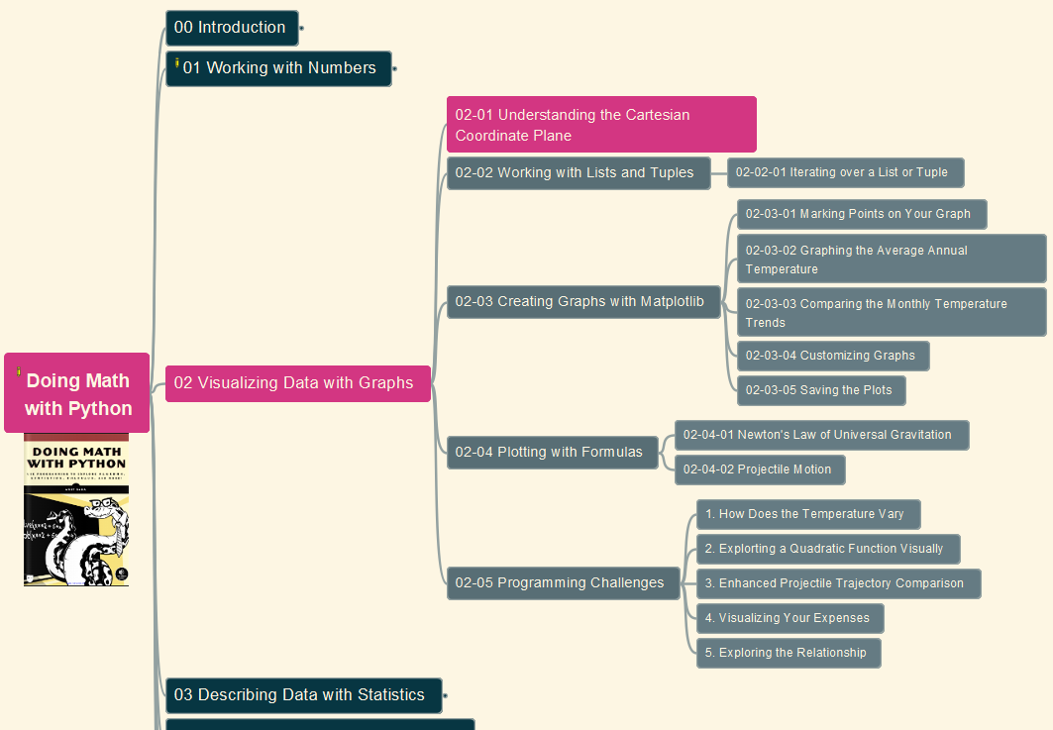
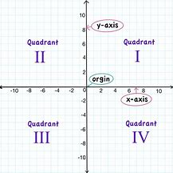
Doing Math with Python
014
Chapter 02: Visualizing Data with Graphs
02-01: Understanding the Cartesian Coordinate Plane
GitHub: https://github.com/yasenstar/DoingMathWithPython
Gitee: https://gitee.com/yasenstar/DoingMathWithPython
Yasen – Enterprise Architecture
YouTube: @yasenzhao

Slide 17
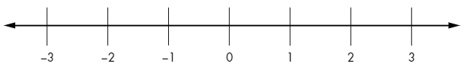
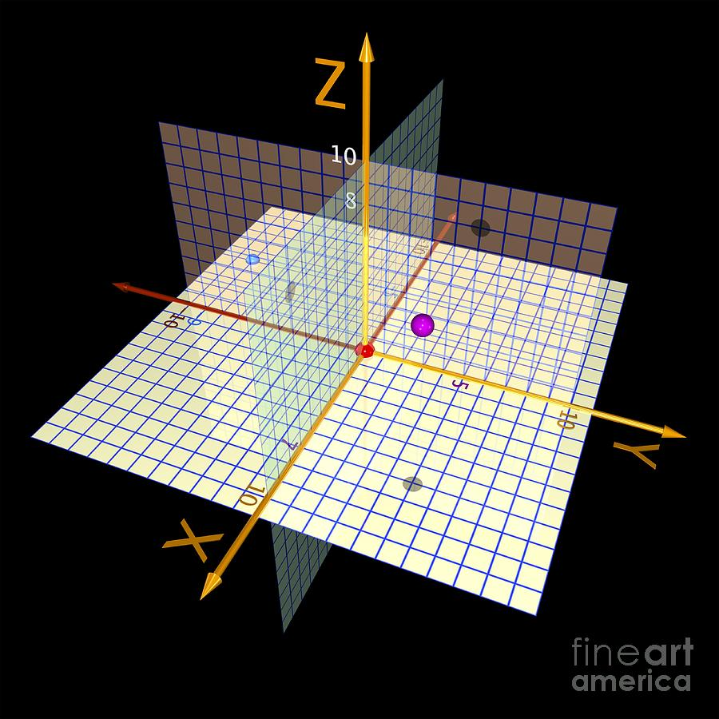
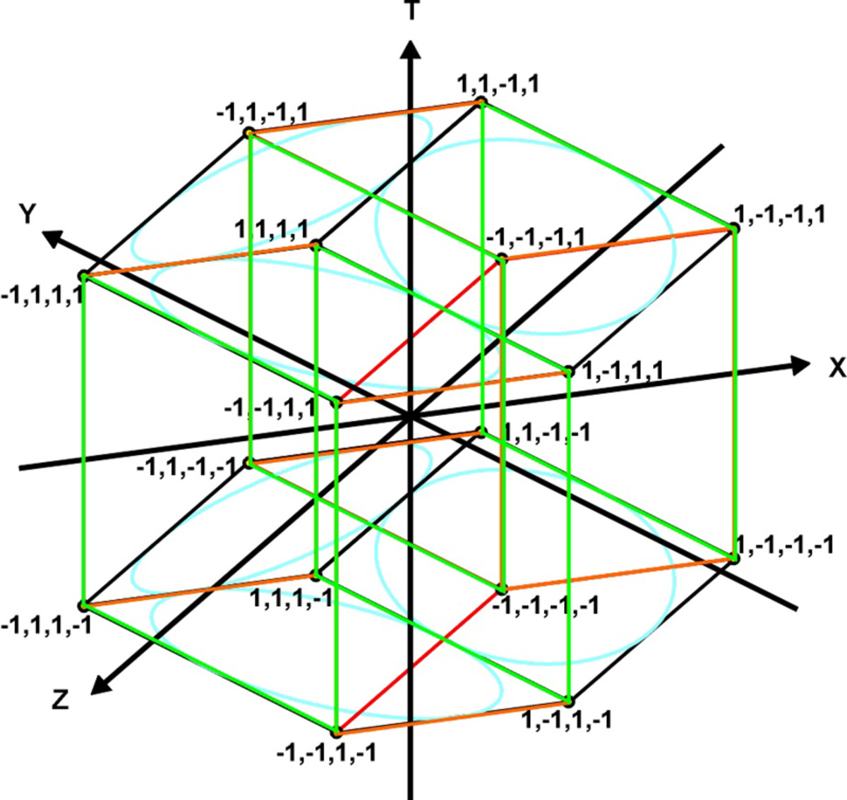
Cartesian Coordinates Plane
1 Dimension – number line
2 Dimensions
3 Dimensions
4 Dimensions

Slide 18
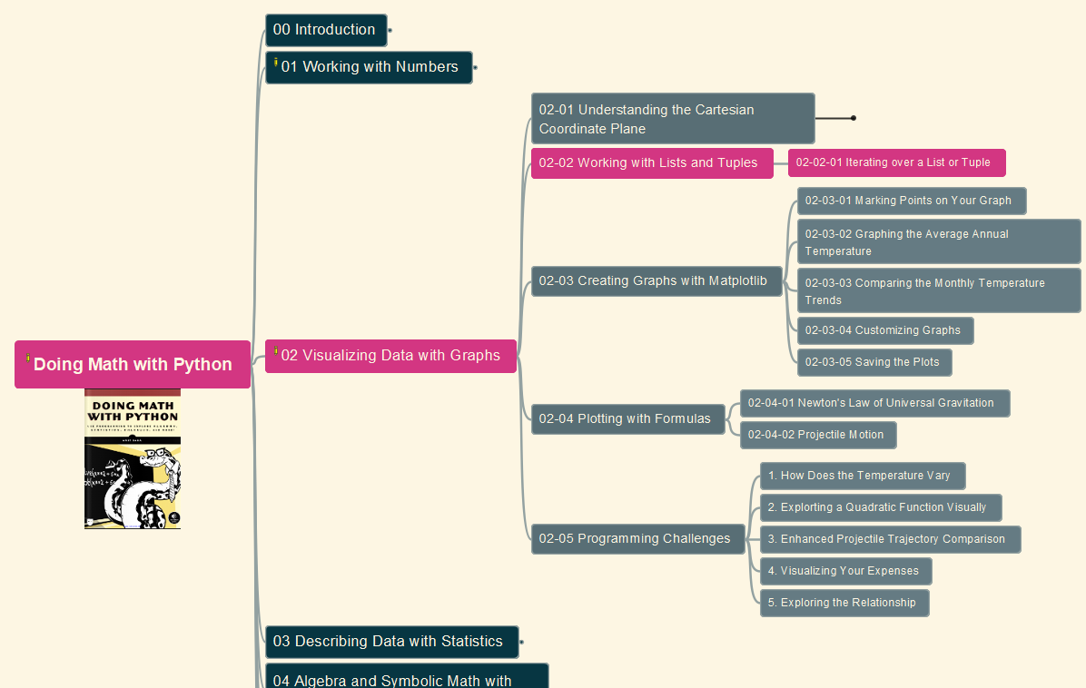
Doing Math with Python
015
Chapter 02: Visualizing Data with Graphs
02-02: Working with Lists and Tuples
GitHub: https://github.com/yasenstar/DoingMathWithPython
Gitee: https://gitee.com/yasenstar/DoingMathWithPython
Yasen – Enterprise Architecture
YouTube: @yasenzhao

Slide 19
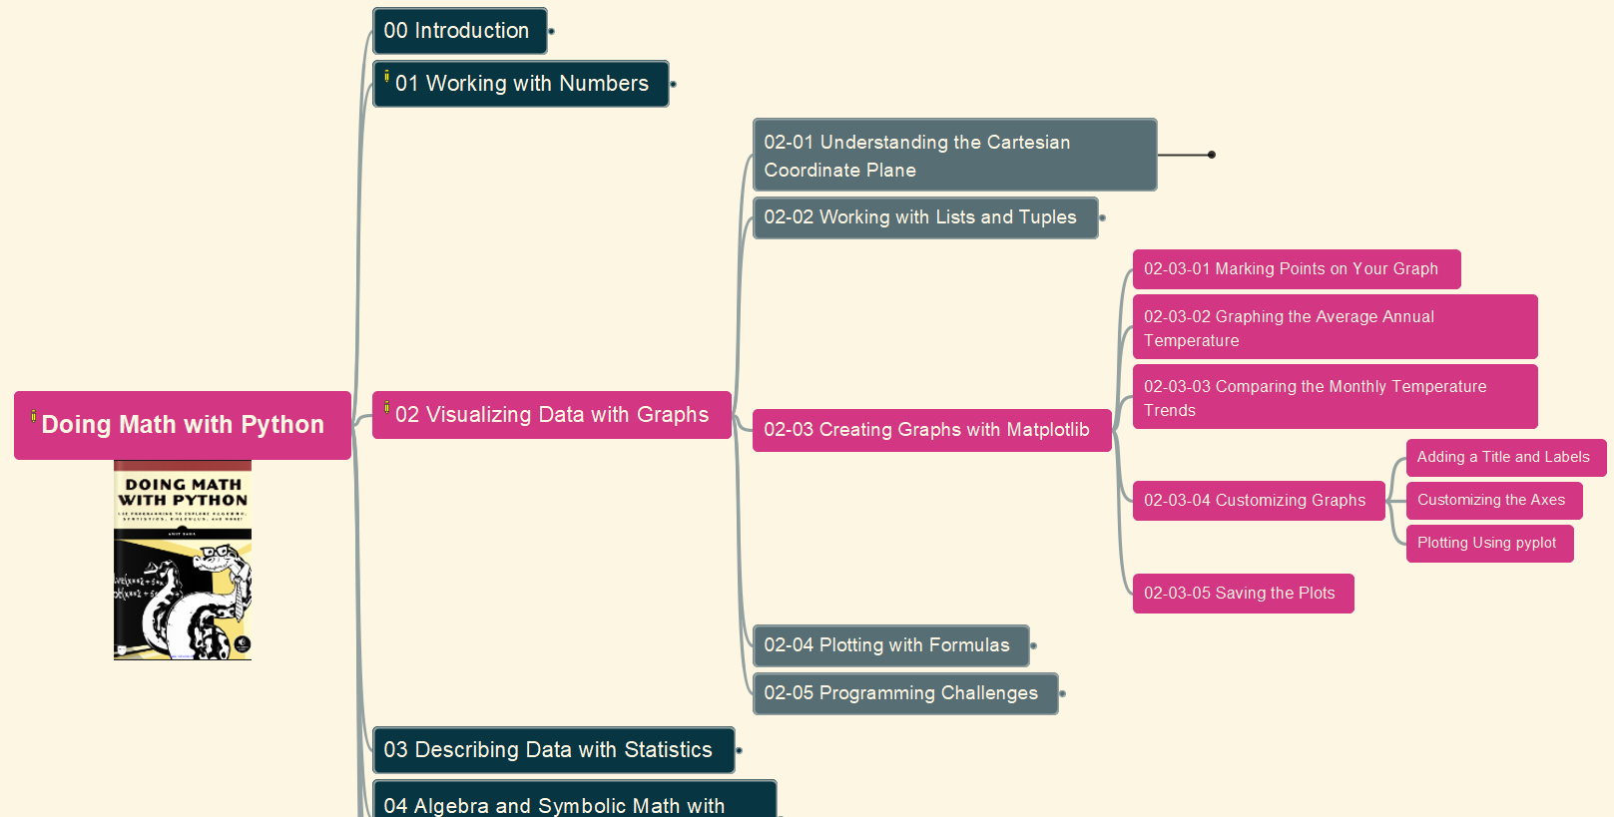
Doing Math with Python
016
Chapter 02: Visualizing Data with Graphs
02-03: Creating Graphs with Matplotlib (& pylab)
GitHub: https://github.com/yasenstar/DoingMathWithPython
Gitee: https://gitee.com/yasenstar/DoingMathWithPython
Yasen – Enterprise Architecture
YouTube: @yasenzhao

Slide 20
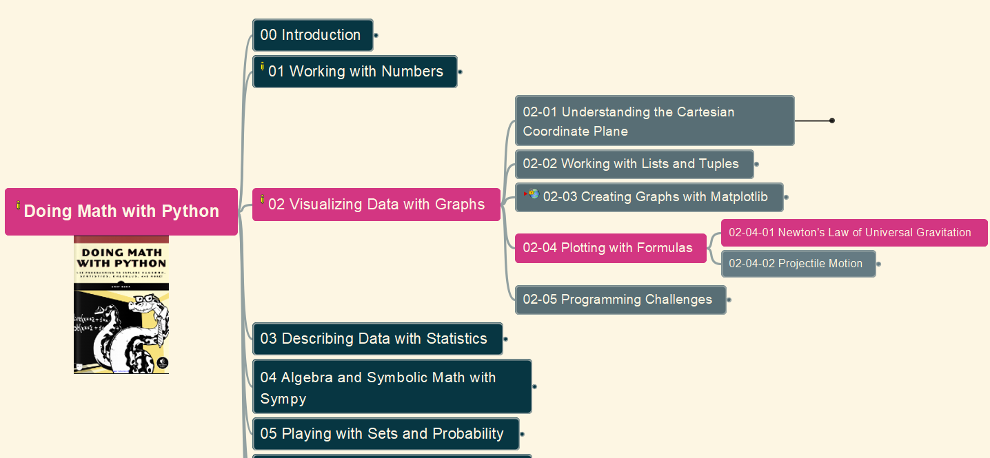
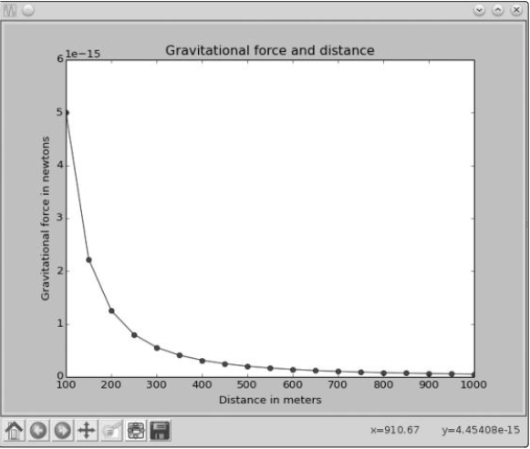
Doing Math with Python
017
Chapter 02: Visualizing Data with Graphs
02-04 (1): Newtons Law of Universal Gravitation
GitHub: https://github.com/yasenstar/DoingMathWithPython
Gitee: https://gitee.com/yasenstar/DoingMathWithPython
Yasen – Enterprise Architecture
YouTube: @yasenzhao

Slide 21
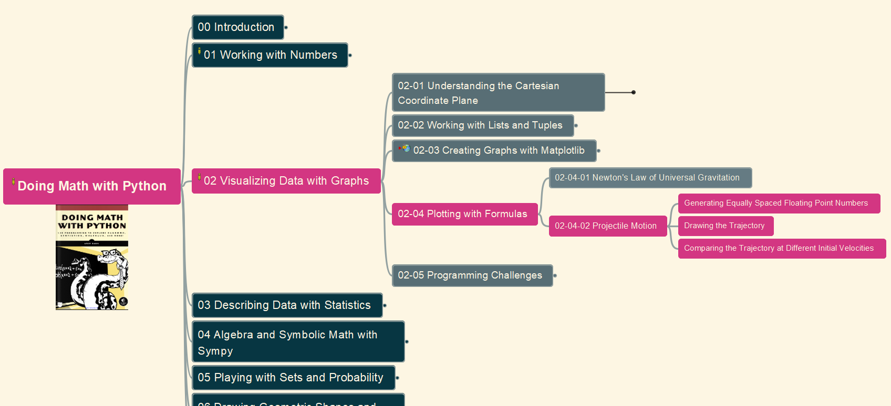
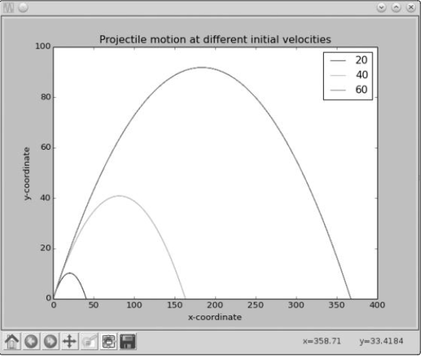
Doing Math with Python
018
Chapter 02: Visualizing Data with Graphs
02-04 (2): Projectile Motion
GitHub: https://github.com/yasenstar/DoingMathWithPython
Gitee: https://gitee.com/yasenstar/DoingMathWithPython
Yasen – Enterprise Architecture
YouTube: @yasenzhao

Slide 22
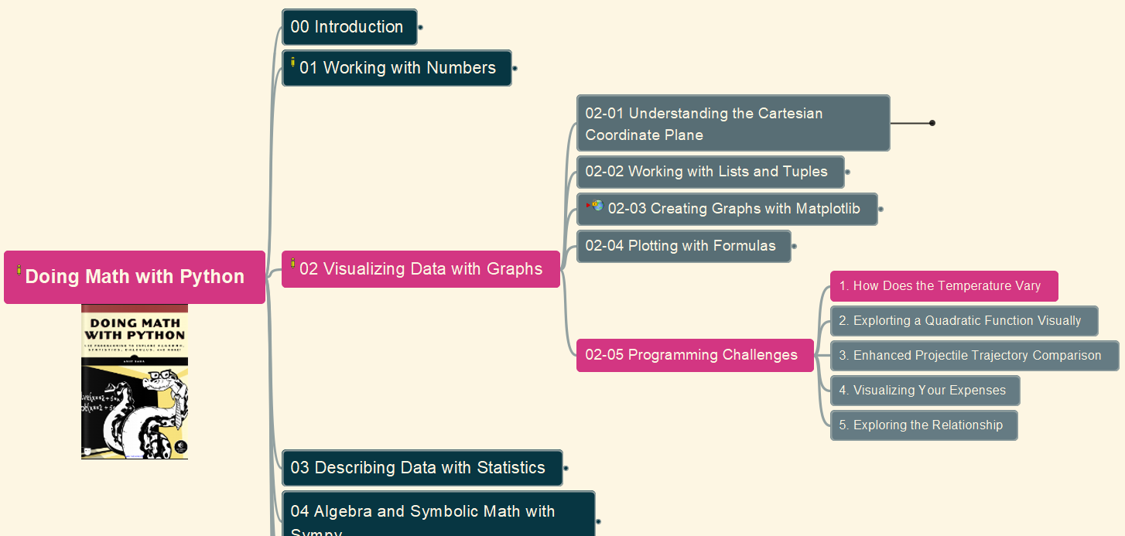
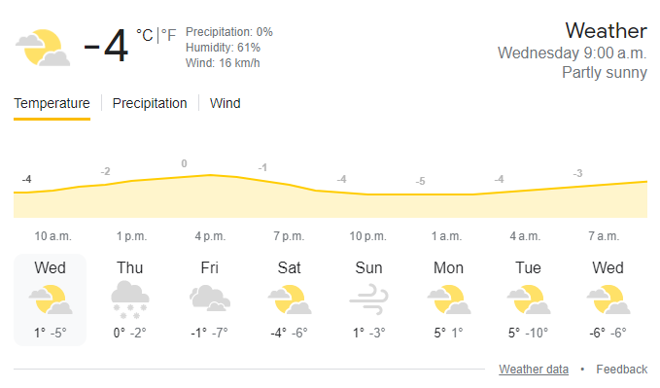
Doing Math with Python
019
Chapter 02: Visualizing Data with Graphs
02-05: Programming Challenges
(1) Vary Temperature in a Day
GitHub: https://github.com/yasenstar/DoingMathWithPython
Gitee: https://gitee.com/yasenstar/DoingMathWithPython
Yasen – Enterprise Architecture
YouTube: @yasenzhao

Slide 23
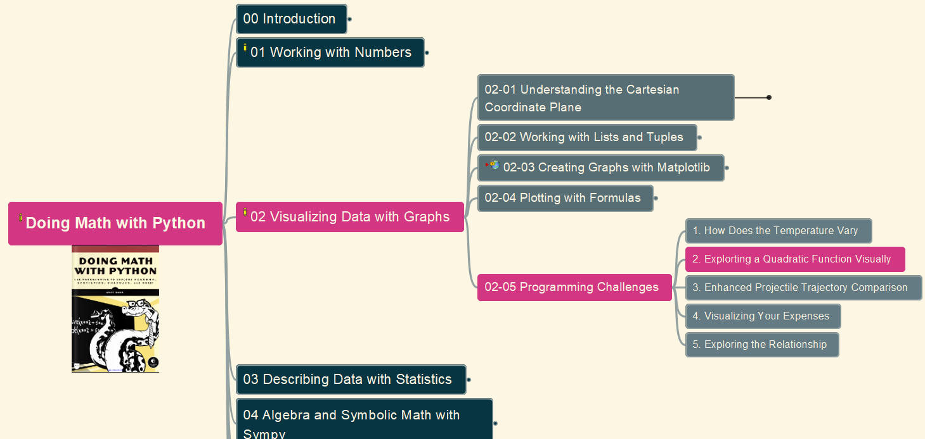
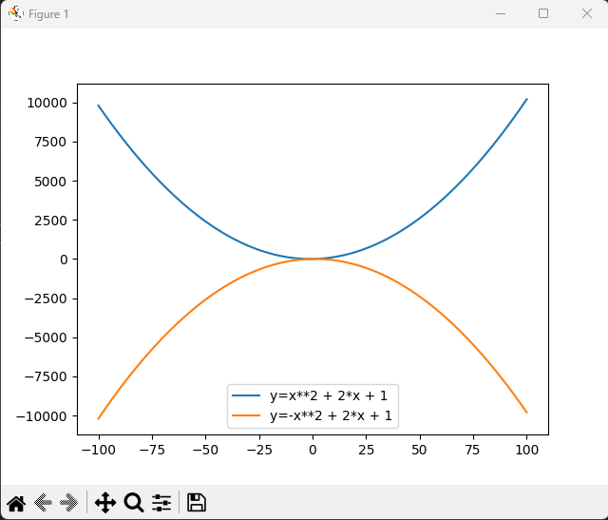
Doing Math with Python
020
Chapter 02: Visualizing Data with Graphs
02-05: Programming Challenges
(2) Visualize Quadratic Function
GitHub: https://github.com/yasenstar/DoingMathWithPython
Gitee: https://gitee.com/yasenstar/DoingMathWithPython
Yasen – Enterprise Architecture
YouTube: @yasenzhao

Slide 24
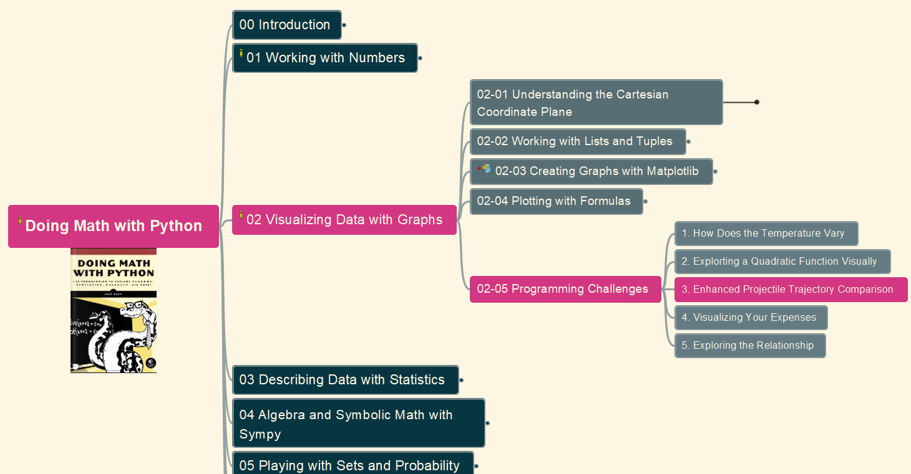
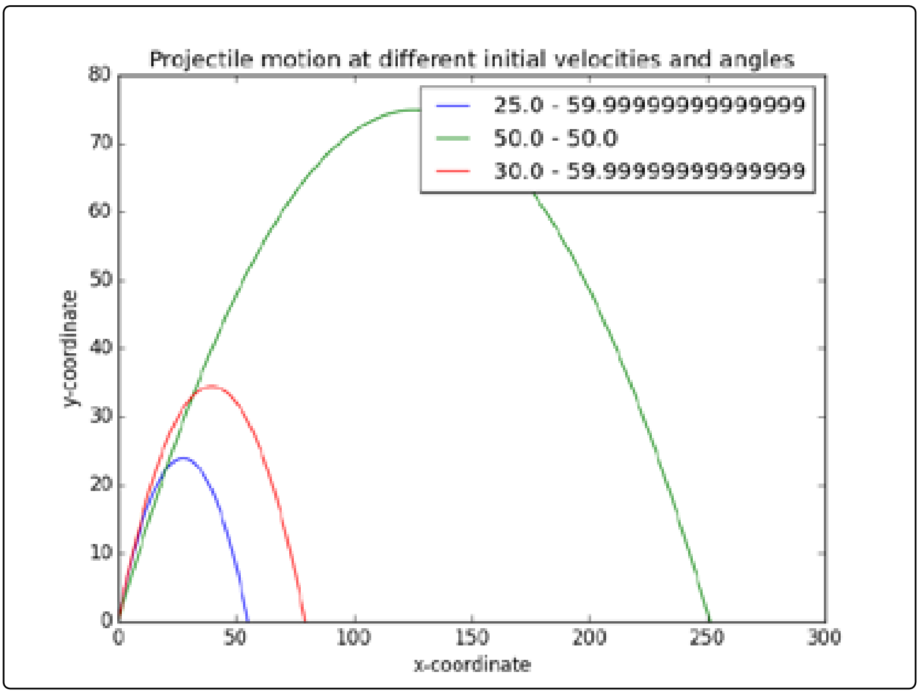
Doing Math with Python
021
Chapter 02: Visualizing Data with Graphs
02-06: Programming Challenges
(3) Enhanced Projectile Trajectory Comparison Program
GitHub: https://github.com/yasenstar/DoingMathWithPython
Gitee: https://gitee.com/yasenstar/DoingMathWithPython
Yasen – Enterprise Architecture
YouTube: @yasenzhao

Slide 25
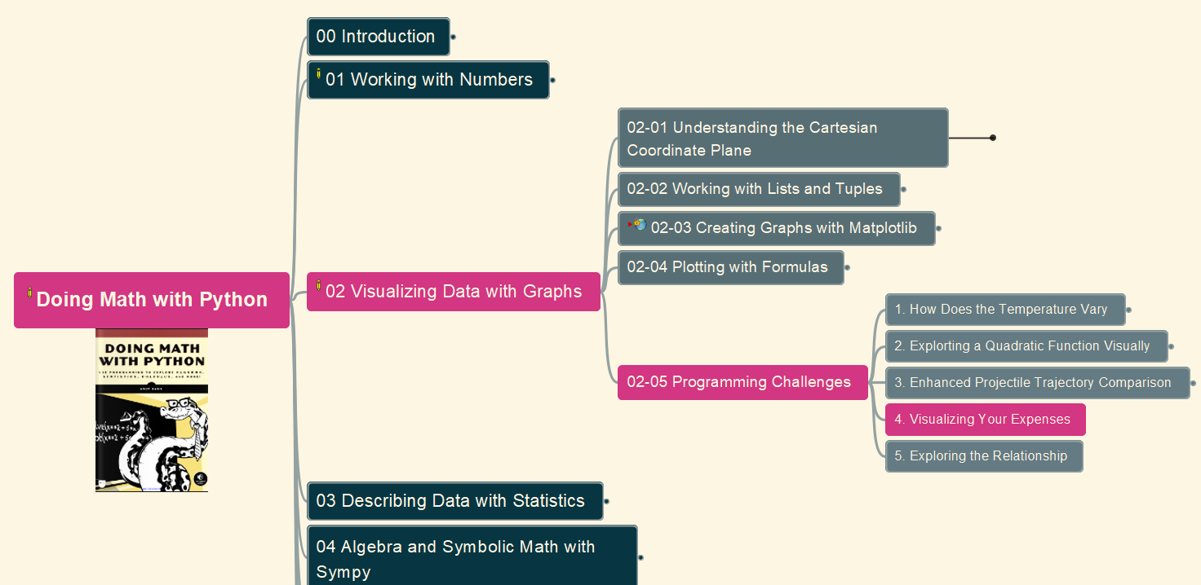
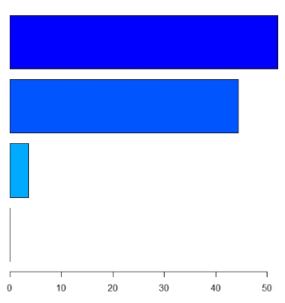
Doing Math with Python
022
Chapter 02: Visualizing Data with Graphs
02-05: Programming Challenges
(4) Visualizing Your Expenses
GitHub: https://github.com/yasenstar/DoingMathWithPython
Gitee: https://gitee.com/yasenstar/DoingMathWithPython
Yasen – Enterprise Architecture
YouTube: @yasenzhao

Slide 26
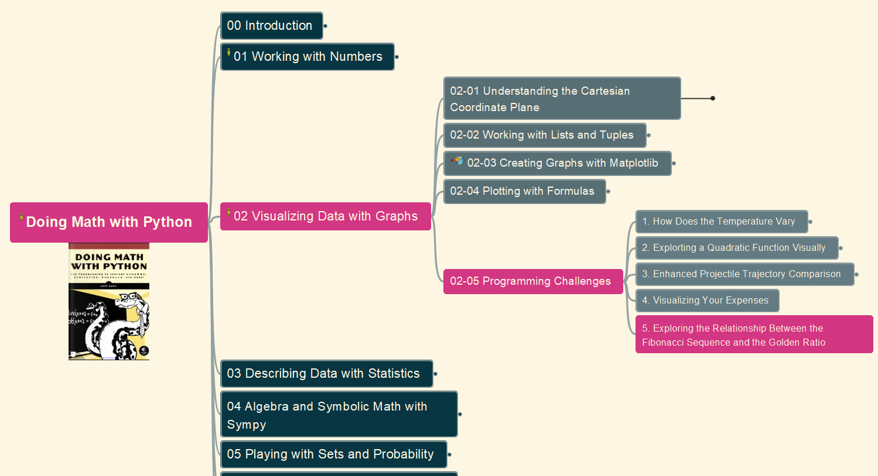
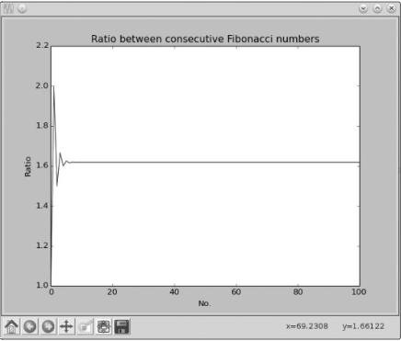
Doing Math with Python
023
Chapter 02: Visualizing Data with Graphs
02-05: Programming Challenges
(5) Relationship between Fibonacci Sequence and the Golden Ratio
GitHub: https://github.com/yasenstar/DoingMathWithPython
Gitee: https://gitee.com/yasenstar/DoingMathWithPython
Yasen – Enterprise Architecture
YouTube: @yasenzhao

Slide 27
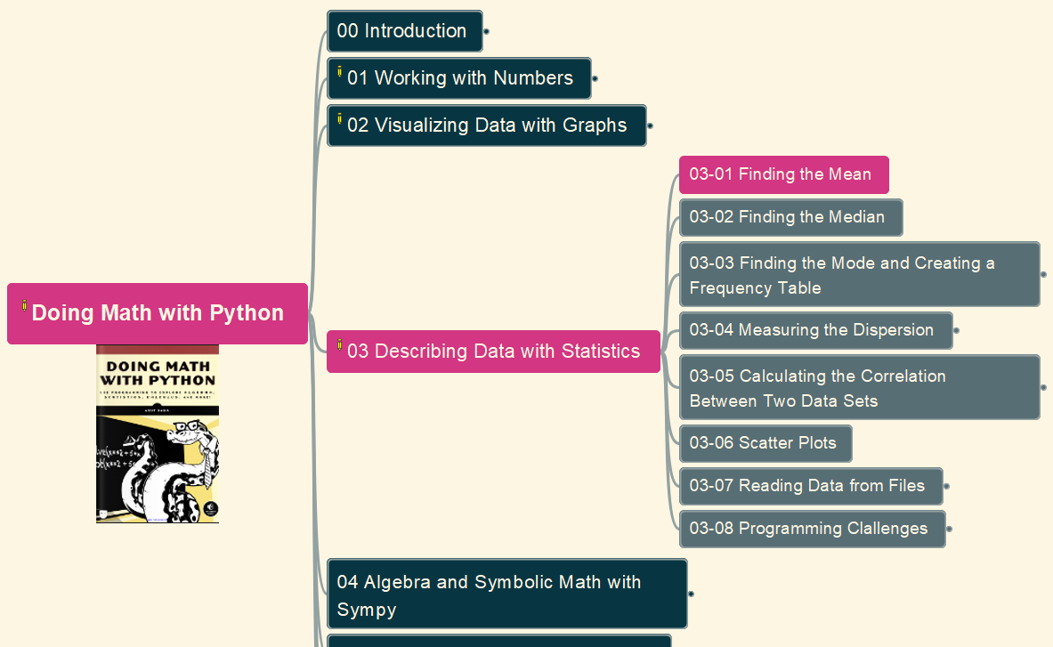
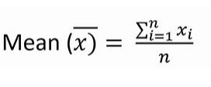
Doing Math with Python
024
Chapter 03: Describing Data with Statistics
03-01: Find the Mean
GitHub: https://github.com/yasenstar/DoingMathWithPython
Gitee: https://gitee.com/yasenstar/DoingMathWithPython
Yasen – Enterprise Architecture
YouTube: @yasenzhao

Slide 28
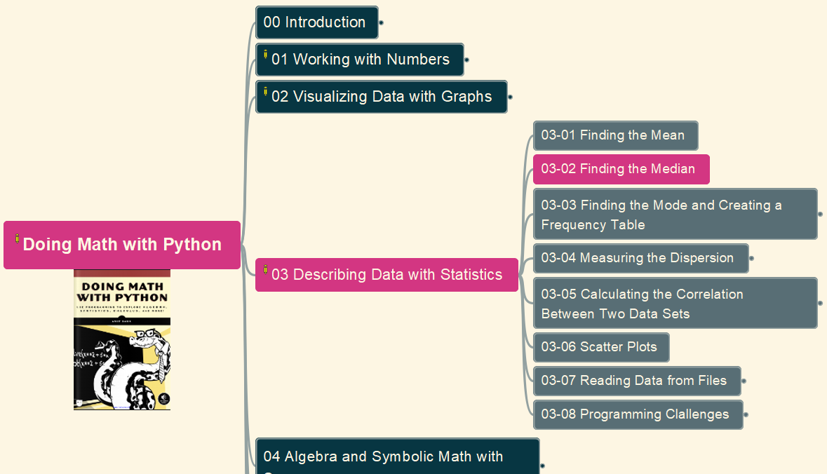
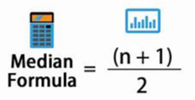
Doing Math with Python
025
Chapter 03: Describing Data with Statistics
03-02: Find the Median
GitHub: https://github.com/yasenstar/DoingMathWithPython
Gitee: https://gitee.com/yasenstar/DoingMathWithPython
Yasen – Enterprise Architecture
YouTube: @yasenzhao

Slide 29
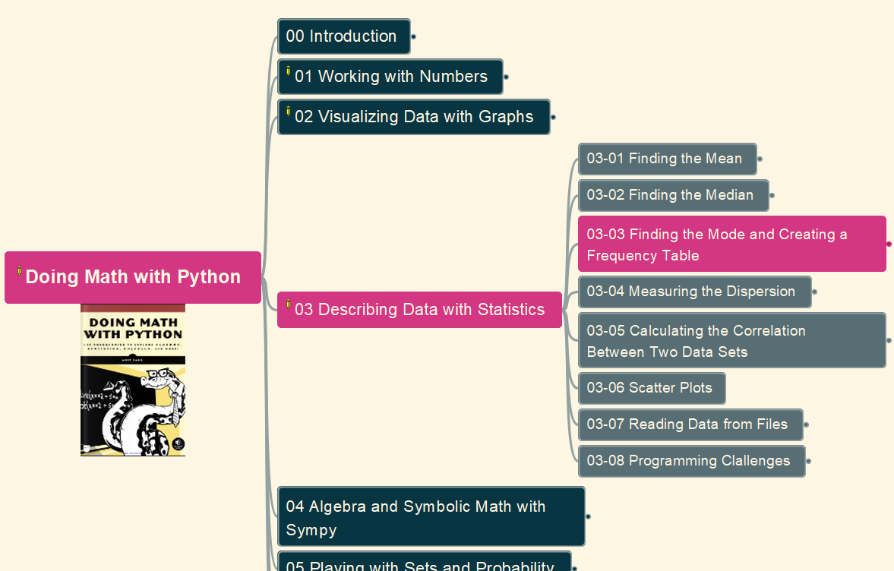
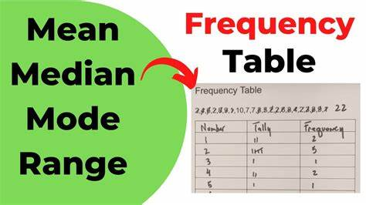
Doing Math with Python
026
Chapter 03: Describing Data with Statistics
03-03 Finding the Mode and Creating a Frequency Table
GitHub: https://github.com/yasenstar/DoingMathWithPython
Gitee: https://gitee.com/yasenstar/DoingMathWithPython
Yasen – Enterprise Architecture
YouTube: @yasenzhao

Slide 30
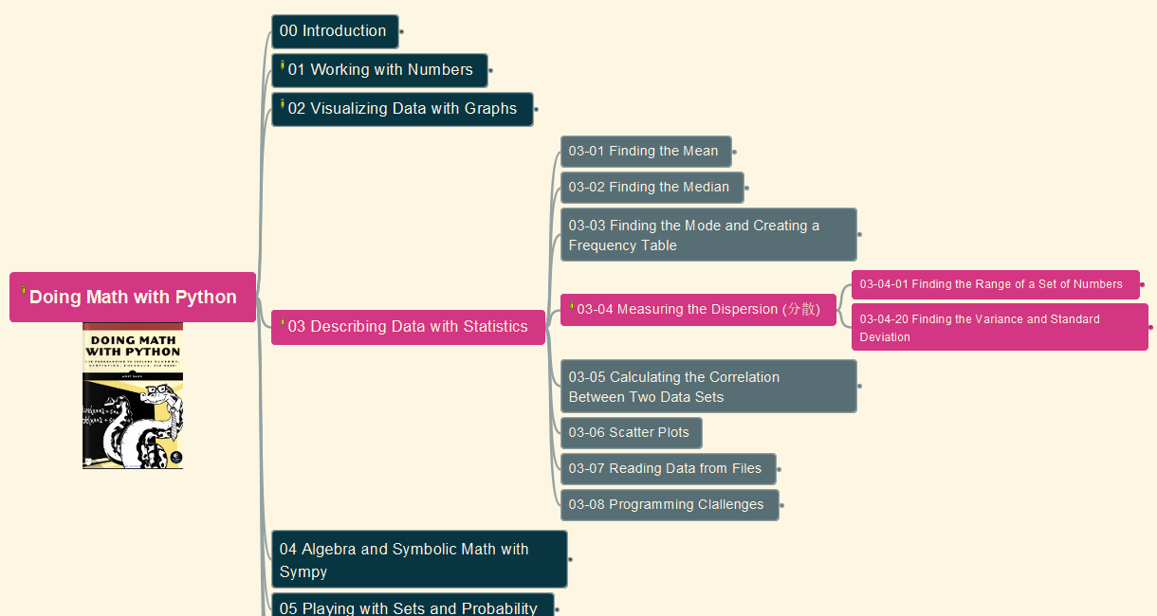
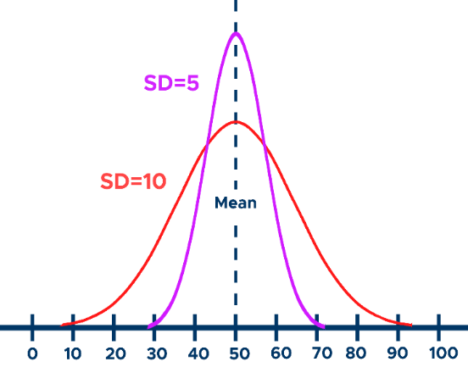
Doing Math with Python
027
Chapter 03: Describing Data with Statistics
03-04 Measuring the Dispersion
GitHub: https://github.com/yasenstar/DoingMathWithPython
Gitee: https://gitee.com/yasenstar/DoingMathWithPython
Yasen – Enterprise Architecture
YouTube: @yasenzhao

Slide 31
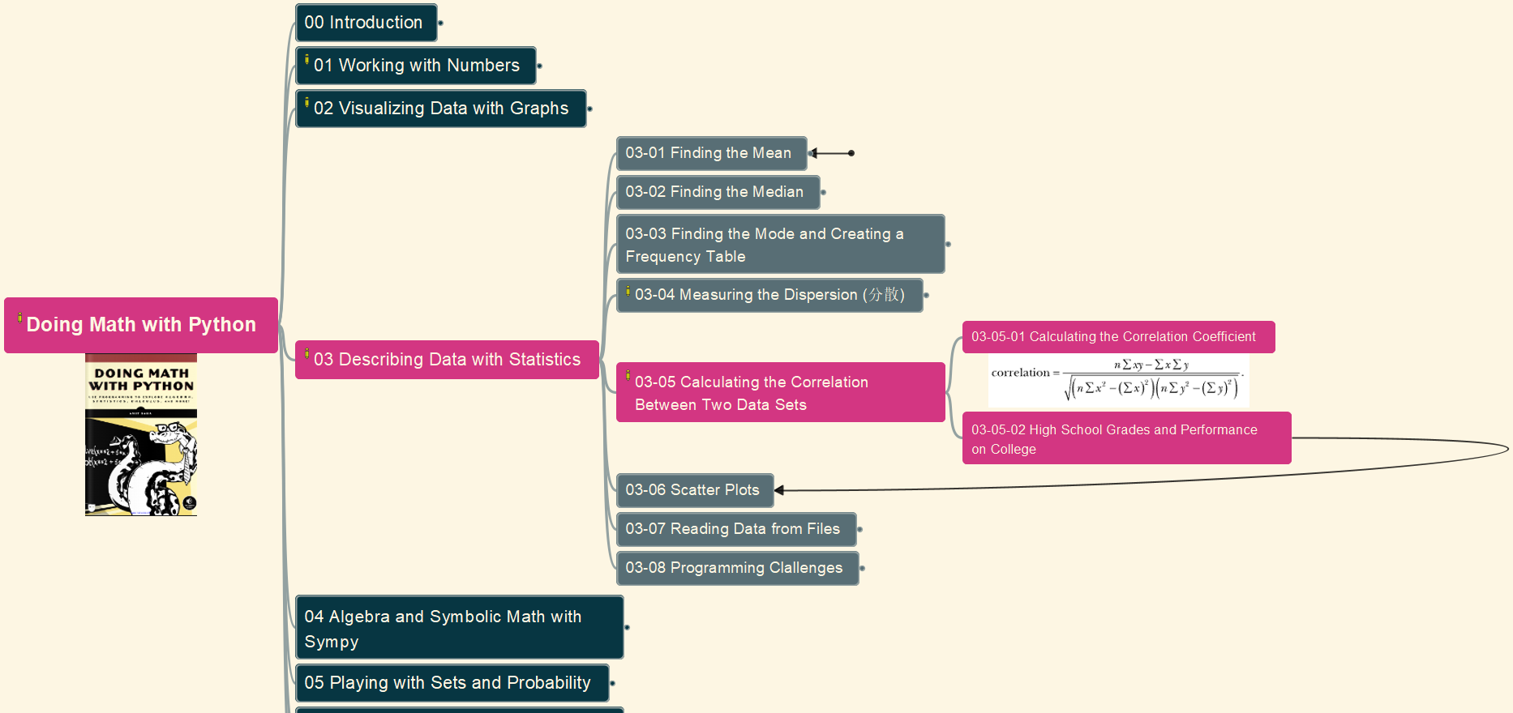
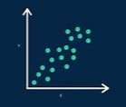
Doing Math with Python
028
Chapter 03: Describing Data with Statistics
03-05 Calculate the Correlation Between Two Data Sets
GitHub: https://github.com/yasenstar/DoingMathWithPython
Gitee: https://gitee.com/yasenstar/DoingMathWithPython
Yasen – Enterprise Architecture
YouTube: @yasenzhao

Slide 32
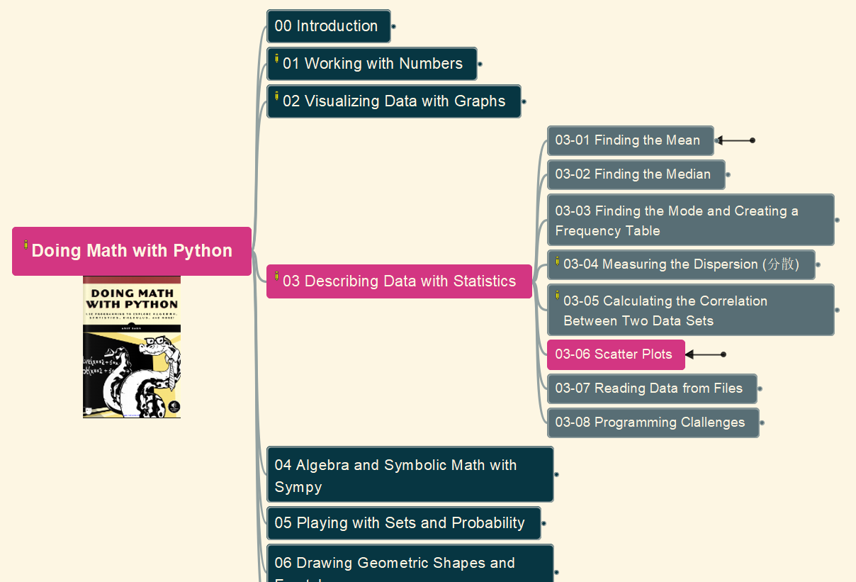
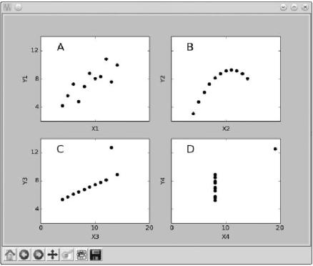
Doing Math with Python
029
Chapter 03: Describing Data with Statistics
03-06 Scatter Plots
GitHub: https://github.com/yasenstar/DoingMathWithPython
Gitee: https://gitee.com/yasenstar/DoingMathWithPython
Yasen – Enterprise Architecture
YouTube: @yasenzhao

Slide 33
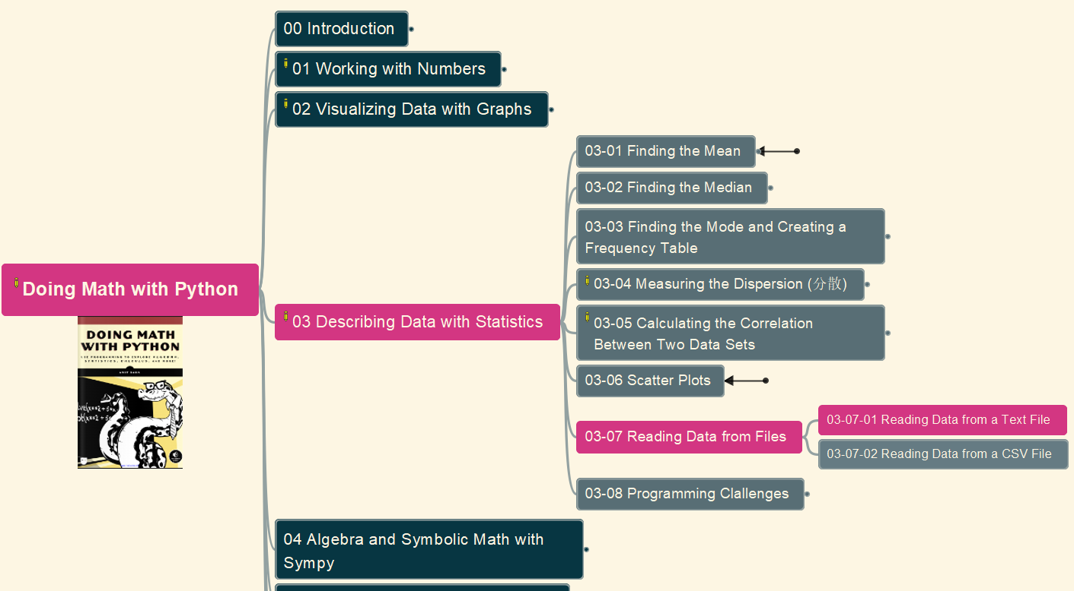

Doing Math with Python
030
Chapter 03: Describing Data with Statistics
03-07 Reading Data from Files
(1) Text File
GitHub: https://github.com/yasenstar/DoingMathWithPython
Gitee: https://gitee.com/yasenstar/DoingMathWithPython
Yasen – Enterprise Architecture
YouTube: @yasenzhao

Slide 34


Doing Math with Python
031
Chapter 03: Describing Data with Statistics
03-07 Reading Data from Files
(2) CSV File
GitHub: https://github.com/yasenstar/DoingMathWithPython
Gitee: https://gitee.com/yasenstar/DoingMathWithPython
Yasen – Enterprise Architecture
YouTube: @yasenzhao

Slide 35

Doing Math with Python
032
Chapter 03: Describing Data with Statistics
03-08 Programming Challenges
#1. Better Correlation Coefficient-Finding Program
GitHub: https://github.com/yasenstar/DoingMathWithPython
Gitee: https://gitee.com/yasenstar/DoingMathWithPython
Yasen – Enterprise Architecture
YouTube: @yasenzhao

Slide 36

Doing Math with Python
033
Chapter 03: Describing Data with Statistics
03-08 Programming Challenges
#2. Statistics Calculator
GitHub: https://github.com/yasenstar/DoingMathWithPython
Gitee: https://gitee.com/yasenstar/DoingMathWithPython
Yasen – Enterprise Architecture
YouTube: @yasenzhao

Slide 37

Doing Math with Python
034
Chapter 03: Describing Data with Statistics
03-08 Programming Challenges
#3. Experiment with Other CSV Data
GitHub: https://github.com/yasenstar/DoingMathWithPython
Gitee: https://gitee.com/yasenstar/DoingMathWithPython
Yasen – Enterprise Architecture
YouTube: @yasenzhao

Slide 38


Doing Math with Python
035
Chapter 03: Describing Data with Statistics
03-08 Programming Challenges
#4. Finding the Percentile
GitHub: https://github.com/yasenstar/DoingMathWithPython
Gitee: https://gitee.com/yasenstar/DoingMathWithPython
Yasen – Enterprise Architecture
YouTube: @yasenzhao

Slide 39
Doing Math with Python
036
Chapter 03: Describing Data with Statistics
03-08 Programming Challenges
#4. Finding the Percentile (cont.)
GitHub: https://github.com/yasenstar/DoingMathWithPython
Gitee: https://gitee.com/yasenstar/DoingMathWithPython
Yasen – Enterprise Architecture
YouTube: @yasenzhao

Slide 40

Doing Math with Python
037
Chapter 03: Describing Data with Statistics
03-08 Programming Challenges
#5. Generate a Grouped Frequency Table
GitHub: https://github.com/yasenstar/DoingMathWithPython
Gitee: https://gitee.com/yasenstar/DoingMathWithPython
Yasen – Enterprise Architecture
YouTube: @yasenzhao

Slide 41


Doing Math with Python
038
Chapter 04: Algebra and Symbolic Math with SymPy
04-00 Installing and Configuring SymPy
GitHub: https://github.com/yasenstar/DoingMathWithPython
Gitee: https://gitee.com/yasenstar/DoingMathWithPython
Yasen – Enterprise Architecture
YouTube: @yasenzhao

Slide 42

Doing Math with Python
039
Chapter 04: Algebra and Symbolic Math with SymPy
04-01 Defining Symbols and Symbolic Operations
GitHub: https://github.com/yasenstar/DoingMathWithPython
Gitee: https://gitee.com/yasenstar/DoingMathWithPython
Yasen – Enterprise Architecture
YouTube: @yasenzhao

Slide 43

Doing Math with Python
040
Chapter 04: Algebra and Symbolic Math with SymPy
04-02 Working with Expressions
GitHub: https://github.com/yasenstar/DoingMathWithPython
Gitee: https://gitee.com/yasenstar/DoingMathWithPython
Yasen – Enterprise Architecture
YouTube: @yasenzhao

Slide 44

Doing Math with Python
041
Chapter 04: Algebra and Symbolic Math with SymPy
04-03 Solving Equations
GitHub: https://github.com/yasenstar/DoingMathWithPython
Gitee: https://gitee.com/yasenstar/DoingMathWithPython
Yasen – Enterprise Architecture
YouTube: @yasenzhao

Slide 45

Doing Math with Python
042
Chapter 04: Algebra and Symbolic Math with SymPy
04-04 Plotting Using SymPy
GitHub: https://github.com/yasenstar/DoingMathWithPython
Gitee: https://gitee.com/yasenstar/DoingMathWithPython
Yasen – Enterprise Architecture
YouTube: @yasenzhao

Slide 46

Doing Math with Python
043
Chapter 04: Algebra and Symbolic Math with SymPy
04-04 Programming Challenges
(1) Factor Finder
GitHub: https://github.com/yasenstar/DoingMathWithPython
Gitee: https://gitee.com/yasenstar/DoingMathWithPython
Yasen – Enterprise Architecture
YouTube: @yasenzhao

Slide 47

Doing Math with Python
044
Chapter 04: Algebra and Symbolic Math with SymPy
04-04 Programming Challenges
(2) Graphical Equation Solver
GitHub: https://github.com/yasenstar/DoingMathWithPython
Gitee: https://gitee.com/yasenstar/DoingMathWithPython
Yasen – Enterprise Architecture
YouTube: @yasenzhao

Slide 48

Doing Math with Python
045
Chapter 04: Algebra and Symbolic Math with SymPy
04-04 Programming Challenges
(3) Summing a Series
GitHub: https://github.com/yasenstar/DoingMathWithPython
Gitee: https://gitee.com/yasenstar/DoingMathWithPython
Yasen – Enterprise Architecture
YouTube: @yasenzhao

Slide 49

Doing Math with Python
046
Chapter 04: Algebra and Symbolic Math with SymPy
04-04 Programming Challenges
(4) Solving Single-Variable Inequalities
GitHub: https://github.com/yasenstar/DoingMathWithPython
Gitee: https://gitee.com/yasenstar/DoingMathWithPython
Yasen – Enterprise Architecture
YouTube: @yasenzhao

Slide 50

Doing Math with Python
047
Chapter 05: Playing with Sets and Probability
05-01 What is a Set?
(1) Concepts, Set Construction
GitHub: https://github.com/yasenstar/DoingMathWithPython
Gitee: https://gitee.com/yasenstar/DoingMathWithPython
Yasen – Enterprise Architecture
YouTube: @yasenzhao

Slide 51


About “Sets Theory”
https://en.wikipedia.org/wiki/Set_theory
Set theory is the branch of mathematical logic that studies sets, which can be informally described as collections of objects. Although objects of any kind can be collected into a set, set theory — as a branch of mathematics — is mostly concerned with those that are relevant to mathematics as a whole.
The modern study of set theory was initiated by the German mathematicians Richard Dedekind and Georg Cantor in the 1870s.

Slide 52




Samples of Sets

Slide 53

Doing Math with Python
048
Chapter 05: Playing with Sets and Probability
05-01 What is a Set?
(2) Sets Relationships
GitHub: https://github.com/yasenstar/DoingMathWithPython
Gitee: https://gitee.com/yasenstar/DoingMathWithPython
Yasen – Enterprise Architecture
YouTube: @yasenzhao

Slide 54

Doing Math with Python
049
Chapter 05: Playing with Sets and Probability
05-01 What is a Set?
(3) Set Operations
GitHub: https://github.com/yasenstar/DoingMathWithPython
Gitee: https://gitee.com/yasenstar/DoingMathWithPython
Yasen – Enterprise Architecture
YouTube: @yasenzhao

Slide 55

Doing Math with Python
050
Chapter 05: Playing with Sets and Probability
05-02 Probability
(0) Concept (1) Or (2) And
GitHub: https://github.com/yasenstar/DoingMathWithPython
Gitee: https://gitee.com/yasenstar/DoingMathWithPython
Yasen – Enterprise Architecture
YouTube: @yasenzhao

Slide 56

Doing Math with Python
051
Chapter 05: Playing with Sets and Probability
05-02 Probability
(3) Generating Random Numbers
GitHub: https://github.com/yasenstar/DoingMathWithPython
Gitee: https://gitee.com/yasenstar/DoingMathWithPython
Yasen – Enterprise Architecture
YouTube: @yasenzhao

Slide 57

Doing Math with Python
052
Chapter 05: Playing with Sets and Probability
05-02 Probability
(4) Non-Uniform Random Numbers
GitHub: https://github.com/yasenstar/DoingMathWithPython
Gitee: https://gitee.com/yasenstar/DoingMathWithPython
Yasen – Enterprise Architecture
YouTube: @yasenzhao

Slide 58


Doing Math with Python
053
Chapter 05: Playing with Sets and Probability
05-03 Programming Challenges
#1 Using Venn Diagrams to Visualize Relationships Between Sets
GitHub: https://github.com/yasenstar/DoingMathWithPython
Gitee: https://gitee.com/yasenstar/DoingMathWithPython
Yasen – Enterprise Architecture
YouTube: @yasenzhao

Slide 59

Doing Math with Python
054
Chapter 05: Playing with Sets and Probability
05-03 Programming Challenges
#2 Law of Large Numbers
GitHub: https://github.com/yasenstar/DoingMathWithPython
Gitee: https://gitee.com/yasenstar/DoingMathWithPython
Yasen – Enterprise Architecture
YouTube: @yasenzhao

Slide 60

Doing Math with Python
055
Chapter 05: Playing with Sets and Probability
05-03 Programming Challenges
#3 How Many Tosses Before You Run Out of Money?
GitHub: https://github.com/yasenstar/DoingMathWithPython
Gitee: https://gitee.com/yasenstar/DoingMathWithPython
Yasen – Enterprise Architecture
YouTube: @yasenzhao

Slide 61


Doing Math with Python
056
Chapter 05: Playing with Sets and Probability
05-03 Programming Challenges
#4 Shuffling a Deck of Cards
GitHub: https://github.com/yasenstar/DoingMathWithPython
Gitee: https://gitee.com/yasenstar/DoingMathWithPython
Yasen – Enterprise Architecture
YouTube: @yasenzhao

Slide 62


Doing Math with Python
057
Chapter 05: Playing with Sets and Probability
05-03 Programming Challenges
#5 Estimating the Area of a Circle
GitHub: https://github.com/yasenstar/DoingMathWithPython
Gitee: https://gitee.com/yasenstar/DoingMathWithPython
Yasen – Enterprise Architecture
YouTube: @yasenzhao

Slide 63


Doing Math with Python
058
Chapter 06: Drawing Geometric Shapes and Fractals
06-01 Drawing Geometrics Shapes with Matplotlib’s Patches
#1 Drawing a Circle
GitHub: https://github.com/yasenstar/DoingMathWithPython
Gitee: https://gitee.com/yasenstar/DoingMathWithPython
Yasen – Enterprise Architecture
YouTube: @yasenzhao

Slide 64


Doing Math with Python
059
Chapter 06: Drawing Geometric Shapes and Fractals
06-01 Drawing Geometrics Shapes with Matplotlib’s Patches
#2 Creating Animated Figures
GitHub: https://github.com/yasenstar/DoingMathWithPython
Gitee: https://gitee.com/yasenstar/DoingMathWithPython
Yasen – Enterprise Architecture
YouTube: @yasenzhao

Slide 65


Doing Math with Python
060
Chapter 06: Drawing Geometric Shapes and Fractals
06-01 Drawing Geometrics Shapes with Matplotlib’s Patches
#3 Animating Projectile’s Trajectory
GitHub: https://github.com/yasenstar/DoingMathWithPython
Gitee: https://gitee.com/yasenstar/DoingMathWithPython
Yasen – Enterprise Architecture
YouTube: @yasenzhao

Slide 66

Doing Math with Python
061
Chapter 06: Drawing Geometric Shapes and Fractals
06-02 Drawing Fractals (分形)
#1 Transformations of Points in a Plane
GitHub: https://github.com/yasenstar/DoingMathWithPython
Gitee: https://gitee.com/yasenstar/DoingMathWithPython
Yasen – Enterprise Architecture
YouTube: @yasenzhao

Slide 67


Doing Math with Python
062
Chapter 06: Drawing Geometric Shapes and Fractals
06-02 Drawing Fractals (分形)
#2 Drawing the Barnsley Fern
GitHub: https://github.com/yasenstar/DoingMathWithPython
Gitee: https://gitee.com/yasenstar/DoingMathWithPython
Yasen – Enterprise Architecture
YouTube: @yasenzhao

Slide 68


Doing Math with Python
063
Chapter 06: Drawing Geometric Shapes and Fractals
06-03 Programming Challenges
#1 Packing Circles into a Square
GitHub: https://github.com/yasenstar/DoingMathWithPython
Gitee: https://gitee.com/yasenstar/DoingMathWithPython
Yasen – Enterprise Architecture
YouTube: @yasenzhao

Slide 69


Doing Math with Python
064
Chapter 06: Drawing Geometric Shapes and Fractals
06-03 Programming Challenges
#2 Draw Sierpiński Triangle
GitHub: https://github.com/yasenstar/DoingMathWithPython
Gitee: https://gitee.com/yasenstar/DoingMathWithPython
Yasen – Enterprise Architecture
YouTube: @yasenzhao

Slide 70


Doing Math with Python
065
Chapter 06: Drawing Geometric Shapes and Fractals
06-03 Programming Challenges
#3 Explore Henon’s Function
GitHub: https://github.com/yasenstar/DoingMathWithPython
Gitee: https://gitee.com/yasenstar/DoingMathWithPython
Yasen – Enterprise Architecture
YouTube: @yasenzhao

Slide 71


Doing Math with Python
066
Chapter 06: Drawing Geometric Shapes and Fractals
06-03 Programming Challenges
#4 Draw Mandelbrot Set
(1) imshow() and (2) Lists List
GitHub: https://github.com/yasenstar/DoingMathWithPython
Gitee: https://gitee.com/yasenstar/DoingMathWithPython
Yasen – Enterprise Architecture
YouTube: @yasenzhao

Slide 72


Doing Math with Python
067
Chapter 06: Drawing Geometric Shapes and Fractals
06-03 Programming Challenges
#4 Draw Mandelbrot Set
(3) Mandelbrot Set
GitHub: https://github.com/yasenstar/DoingMathWithPython
Gitee: https://gitee.com/yasenstar/DoingMathWithPython
Yasen – Enterprise Architecture
YouTube: @yasenzhao

Slide 73

Doing Math with Python
068
Chapter 07: Solving Calculus Problems
07-01 What is a Function
GitHub: https://github.com/yasenstar/DoingMathWithPython
Gitee: https://gitee.com/yasenstar/DoingMathWithPython
Yasen – Enterprise Architecture
YouTube: @yasenzhao

Slide 74

Doing Math with Python
069
Chapter 07: Solving Calculus Problems
07-02 Assumptions in SymPy
07-03 Finding the Limit of Functions
GitHub: https://github.com/yasenstar/DoingMathWithPython
Gitee: https://gitee.com/yasenstar/DoingMathWithPython
Yasen – Enterprise Architecture
YouTube: @yasenzhao

Slide 75

Doing Math with Python
070
Chapter 07: Solving Calculus Problems
07-04 Finding the Derivative of Functions
GitHub: https://github.com/yasenstar/DoingMathWithPython
Gitee: https://gitee.com/yasenstar/DoingMathWithPython
Yasen – Enterprise Architecture
YouTube: @yasenzhao

Slide 76

Doing Math with Python
071
Chapter 07: Solving Calculus Problems
07-05 Higher-Order Derivatives and Finding the Maxima and Minima
GitHub: https://github.com/yasenstar/DoingMathWithPython
Gitee: https://gitee.com/yasenstar/DoingMathWithPython
Yasen – Enterprise Architecture
YouTube: @yasenzhao

Slide 77

Doing Math with Python
072
Chapter 07: Solving Calculus Problems
07-06 Finding the Global Maximum using Gradient Ascent
#0 Build a Basic “grad_ascent()
#1 A Generic Program for Gradient Ascent
GitHub: https://github.com/yasenstar/DoingMathWithPython
Gitee: https://gitee.com/yasenstar/DoingMathWithPython
Yasen – Enterprise Architecture
YouTube: @yasenzhao

Slide 78

Doing Math with Python
073
Chapter 07: Solving Calculus Problems
07-06 Finding the Global Maximum using Gradient Ascent
#2 A Word of Warning about the Initial Value
#3 The Role of the Step Size and Epsilon
GitHub: https://github.com/yasenstar/DoingMathWithPython
Gitee: https://gitee.com/yasenstar/DoingMathWithPython
Yasen – Enterprise Architecture
YouTube: @yasenzhao

Slide 79

Doing Math with Python
074
Chapter 07: Solving Calculus Problems
07-07 Finding the Integrals of Functions
07-08 Probability Density Functions
GitHub: https://github.com/yasenstar/DoingMathWithPython
Gitee: https://gitee.com/yasenstar/DoingMathWithPython
Yasen – Enterprise Architecture
YouTube: @yasenzhao

Slide 80


Doing Math with Python
075
Chapter 07: Solving Calculus Problems
07-09 Programming Challenges
#1 Verify the Continuity of a Function at a Point
GitHub: https://github.com/yasenstar/DoingMathWithPython
Gitee: https://gitee.com/yasenstar/DoingMathWithPython
Yasen – Enterprise Architecture
YouTube: @yasenzhao

Slide 81

Doing Math with Python
076
Chapter 07: Solving Calculus Problems
07-09 Programming Challenges
#2 Implement the Gradient Descent
GitHub: https://github.com/yasenstar/DoingMathWithPython
Gitee: https://gitee.com/yasenstar/DoingMathWithPython
Yasen – Enterprise Architecture
YouTube: @yasenzhao

Slide 82

Doing Math with Python
077
Chapter 07: Solving Calculus Problems
07-09 Programming Challenges
#3 Area Between Two Curves
GitHub: https://github.com/yasenstar/DoingMathWithPython
Gitee: https://gitee.com/yasenstar/DoingMathWithPython
Yasen – Enterprise Architecture
YouTube: @yasenzhao

Slide 83

Doing Math with Python
078
Chapter 07: Solving Calculus Problems
07-09 Programming Challenges
#4 Finding the Length of a Curve
GitHub: https://github.com/yasenstar/DoingMathWithPython
Gitee: https://gitee.com/yasenstar/DoingMathWithPython
Yasen – Enterprise Architecture
YouTube: @yasenzhao

Slide 84


Doing Math with Python Thanks to Author: Amit Saha
079
Summary and Closing
Yourself!
Continuous Learning!
GitHub: https://github.com/yasenstar/DoingMathWithPython
Gitee: https://gitee.com/yasenstar/DoingMathWithPython
Yasen – Enterprise Architecture
YouTube: @yasenzhao

